Slide 1
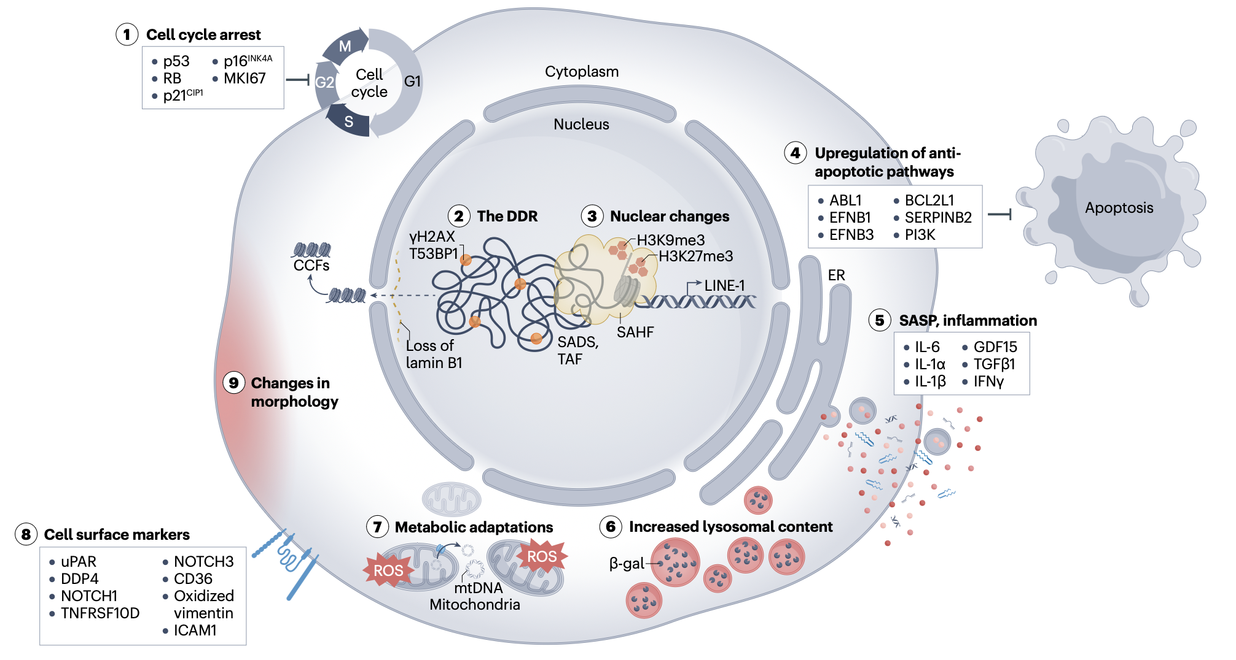
SenNet recommendations for detecting senescent cells in different tissues
Jonathan C. Silverstein, MD
See the interactive visualization of the senescence biomarkers at: https://docs.sennetconsortium.org/biomarkers/
Once considered a tissue culture-specific phenomenon, cellular
senescence has now been linked to various biological processes with both beneficial and detrimental roles in humans, rodents and other species. Much of our understanding of senescent cell biology still originates from tissue culture studies, where each cell in the culture is driven to an irreversible cell cycle arrest. By contrast, in tissues, these cells are relatively rare and difficult to characterize, and it is now established that fully differentiated, postmitotic cells can also acquire a senescence phenotype. The SenNet Biomarkers Working Group was formed to provide recommendations for the use of cellular senescence markers to identify and characterize senescent cells in tissues. Here, we provide recommendations for detecting senescent cells in different tissues based on a comprehensive analysis of existing literature reporting senescence markers in 14 tissues in mice and humans. We discuss some of the recent advances in detecting and characterizing cellular senescence, including molecular senescence signatures and morphological features, and the use of circulating markers. We aim for this work to be a valuable resource for both seasoned investigators in senescence-related studies and newcomers to the field.
Funding Source: NIH
U24CA268108 SenNet
OT2OD026675 HuBMAP
Suryadevara V, Hudgins AD, Rajesh A, … Silverstein JC, …Neretti N. SenNet recommendations for detecting senescent cells in different tissues. Nat Rev Mol Cell Biol. 2024 Jun 3; Available at: http://dx.doi.org/10.1038/s41580-024-00738-8 PMID: 38831121

