Slide 1
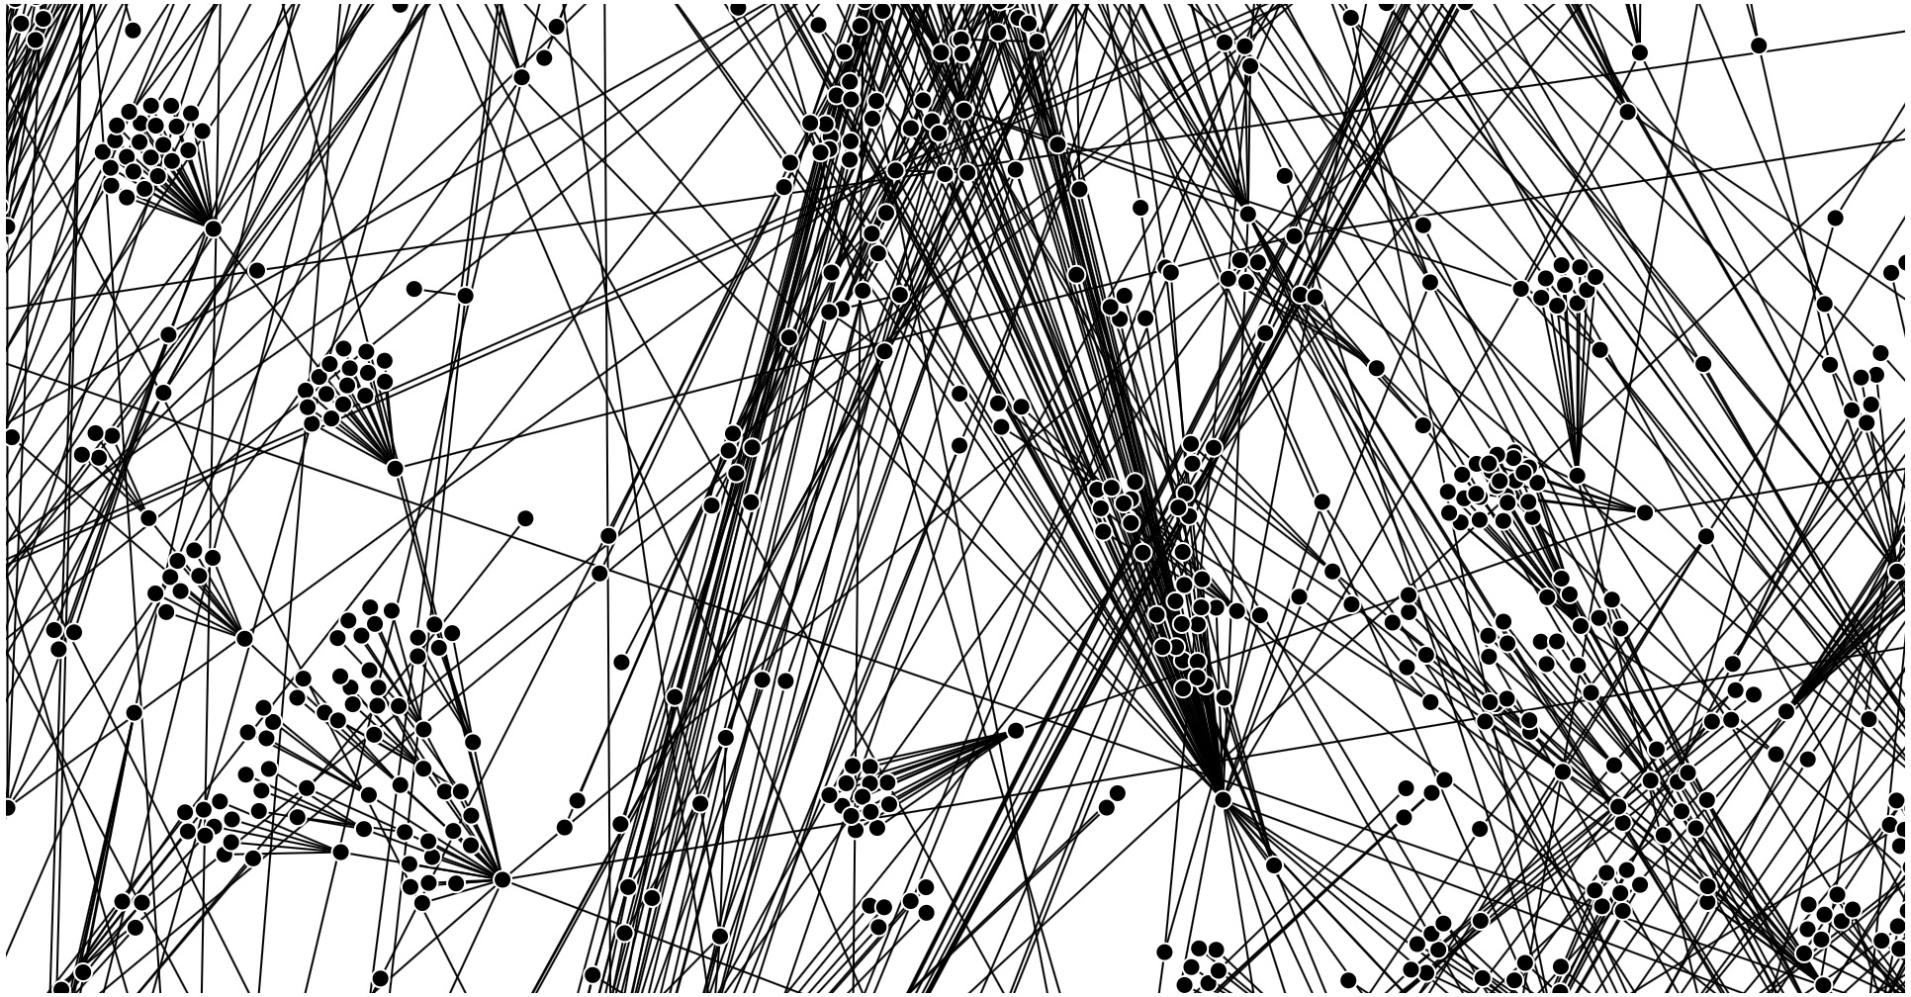
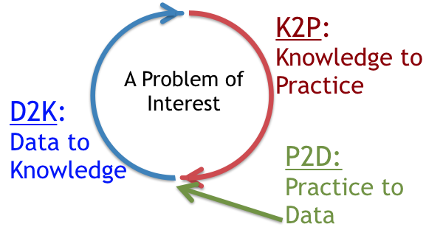
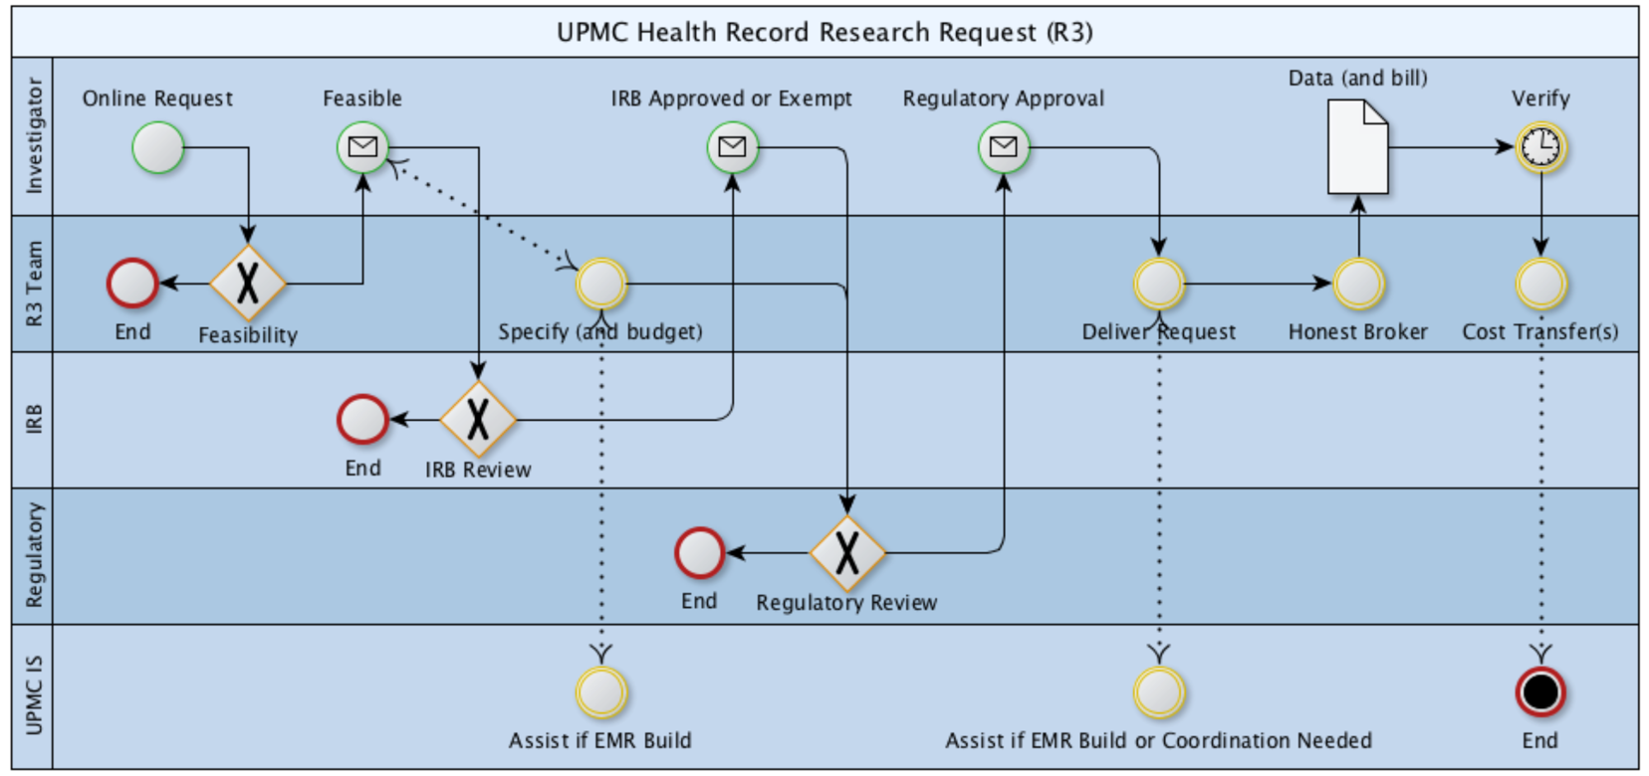
Jonathan C. Silverstein, MD, MS, FACS, FACMI
Chief Research Informatics Officer
Health Sciences and Institute for Precision Medicine
Professor, Department of Biomedical Informatics
Affiliate Scholar, Pitt Cyber
Board Member
Areas of Discovery/Innovation
1. Biomedical Informatics Infrastructures (SaaS, vocab, viz)
2. Learning Health Systems
3. Secure Data Liquidity, Collaborative Networks
PEER-REVIEWED PUBLICATIONS: Curated bibliography at NCBI/PubMed. Curated citations at Google Scholar.

Slide 2
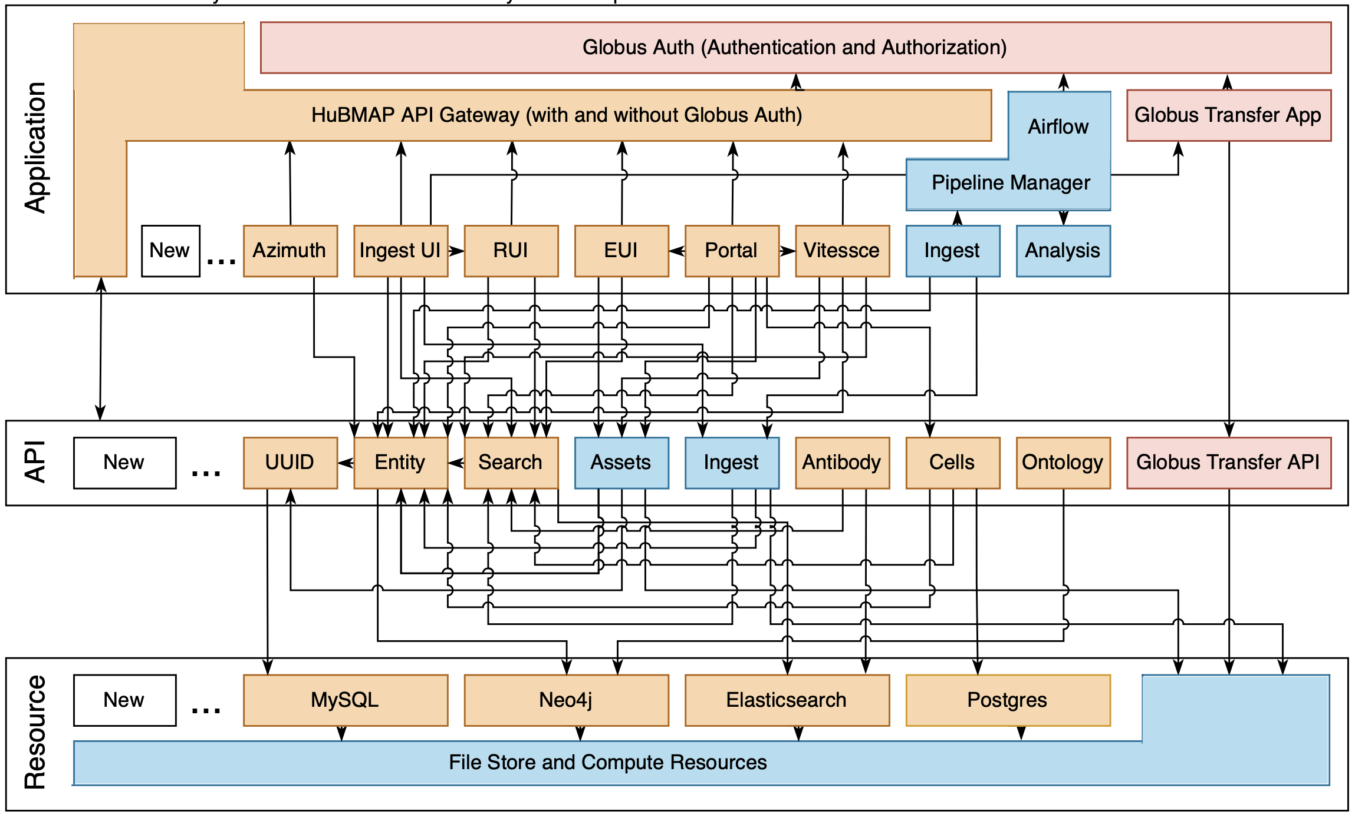
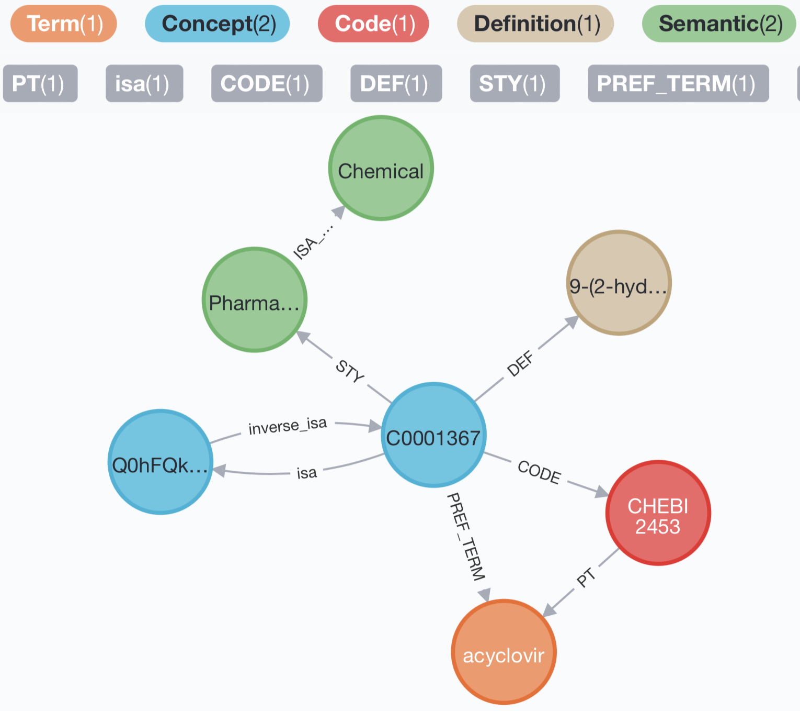
Biomedical Infrastructures (service architectures, vocabularies, interactive viz)
HuBMAP
Hybrid Cloud
Microservices
Architecture
https://software.docs.hubmapconsortium.org
Grayscale + Realistic Color = Perceptual
Knowledge Graph ‘Schema’

Slide 3
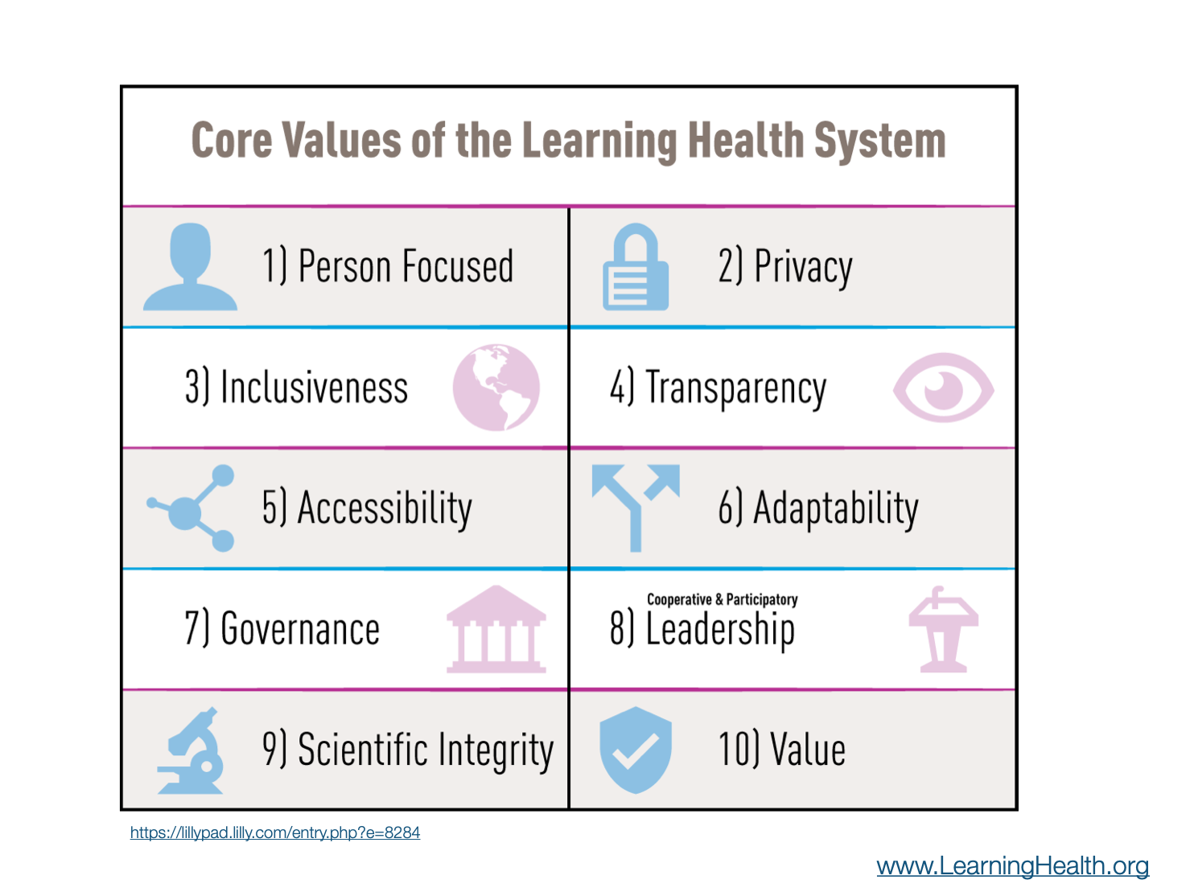
Learning Health Systems

Slide 4
Secure Data Liquidity, Collaborative Networks
R3
Health Record Research Request
Cellular Senescence Network

Slide 5
Active Research Networks as of Dec 2024
U24OH009077 (Becich) CDC/NIH/NIOSH 0.6 calendar
Sustaining the Expansion of the National Mesothelioma Virtual Bank (NMVB)
RI-CRN-2020-006 (McTigue; Becich) PCORI 1.2 calendar
Advancement of PCORnet Infrastructure: Clinical Research Network Project
UL1TR001857 (Reis) NIH/NCATS 1.8 calendar
Biomedical Informatics Core, Clinical and Translational Science Institute
OT2OD026675 (Blood; Silverstein) NIH/Office of the Director 2.4 calendar
Flexible Hybrid Cloud Infrastructure for Seamless Management of HuBMAP Resources
U24CA268108 (Silverstein; Blood; Bar-Joseph) NIH/NCI 2.4 calendar
Cellular Senescence Network (SenNet) Consortium Organization and Data Coordinating Center (CODCC)
SPEC-20-009 (Silverstein) BCRF 1.2 calendar
Breast Cancer Research Foundation Data Coordination Center
U24OD038422 (Taylor; Silverstein) NIH/CF Data Ecosystem 0.6 calendar
Uncovering the Shared Genetic Origins of Childhood Cancer and Structural Birth Defects
Through Enhanced Data Integration and Analysis with the CFDE Data Distillery Knowledge
Graph

Slide 6
Some 2024 Peer-Reviewed Publications
Suryadevara V, Hudgins AD, Rajesh A, …Silverstein JC, Campisi J, …, Neretti N. SenNet recommendations for detecting senescent cells in different tissues. Nat Rev Mol Cell Biol [Internet]. 2024 Jun 3; Available from: http://dx.doi.org/10.1038/s41580-024-00738-8 PMID: 38831121
Callahan TJ, …Silverstein JC, Hoyt CT, Boyce RD, Malec SA, … Kahn MG, Bada M, Baumgartner WA Jr, Hunter LE. An open source knowledge graph ecosystem for the life sciences. Sci Data [Internet]. 2024 Apr 11;11(1):363. Available from: http://dx.doi.org/10.1038/s41597-024-03171-w PMCID: PMC11009265
Zuley ML, Silverstein J, Logue D, Morgan RS, Bhargava R, McAuliffe PF, Brufsky AM, Bandos AI, Nishikawa RM. Organizational Breast Cancer Data Mart: A Solution for Assessing Outcomes of Imaging and Treatment. JCO Clin Cancer Inform [Internet]. 2024 Apr;8:e2300193. Available from: http://dx.doi.org/10.1200/CCI.23.00193 PMID: 38621193
Schmidt S, Jacobs MA, Kim J, Hall DE, Stitzenberg KB, Kao LS, Brimhall BB, Wang CP, Manuel LS, Su HD, Silverstein JC, Shireman PK. Presentation Acuity and Surgical Outcomes for Patients With Health Insurance Living in Highly Deprived Neighborhoods. JAMA Surg [Internet]. 2024 Feb 7; Available from: http://dx.doi.org/10.1001/jamasurg.2023.7468 PMCID: PMC10851138
Behari J, Bradley A, Townsend K, Becich MJ, Cappella N, Chuang CH, Fernandez SA, Ford DE, Kirchner HL, Morgan R, Paranjape A, Silverstein JC, Williams DA, Donahoo WT, Asrani SK, Ntanios F, Ateya M, Hegeman-Dingle R, McLeod E, McTigue K. Limitations of Noninvasive Tests-Based Population-Level Risk Stratification Strategy for Nonalcoholic Fatty Liver Disease. Dig Dis Sci [Internet]. 2024 Feb;69(2):370–383. Available from: http://dx.doi.org/10.1007/s10620-023-08186-8 PMCID: 6088429
Fan P, Zeng L, Ding Y, Kofler J, Silverstein J, Krivinko J, Sweet RA, Wang L. Combination of antidepressants and antipsychotics as a novel treatment option for psychosis in Alzheimer’s disease. CPT Pharmacometrics Syst Pharmacol [Internet]. 2023 Aug;12(8):1119–1131. Available from: http://dx.doi.org/10.1002/psp4.12979 PMCID: PMC10431054

